Slide 1

Microsoft Cloud Workshop: Intelligent Vending Machine
Steve Belcher

Slide 2
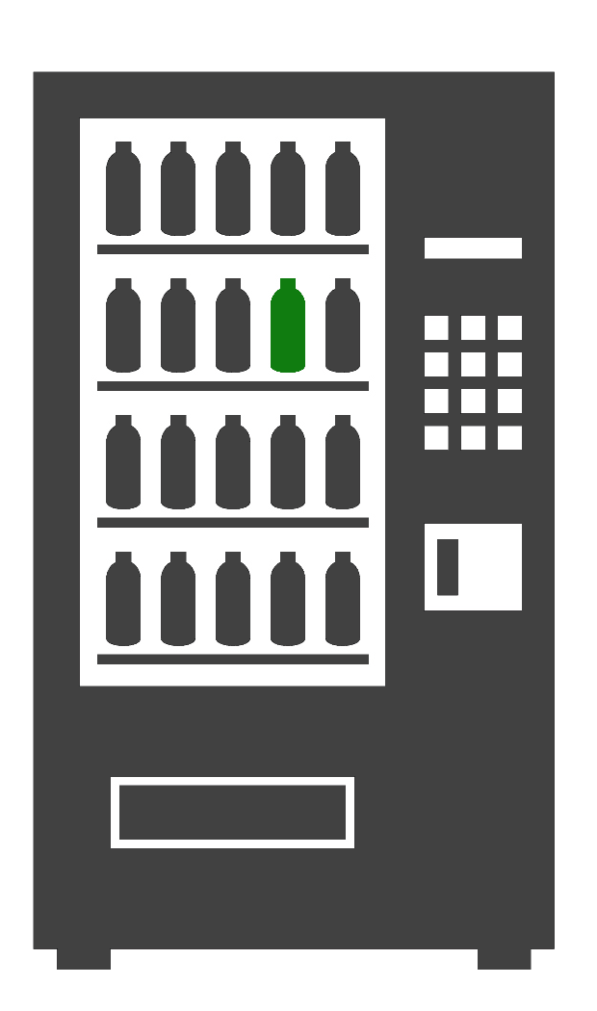
Logistics
Facilities & Breaks
Wireless Access
Azure Subscriptions

Slide 3
Learning Objectives
Explore Azure capabilities in context of business use-case
Build a demonstration solution using some of these capabilities

Slide 4
Agenda
Topic | Minutes
Introductions | 10
Case Study & Azure Technologies | 60
Break | 10
Whiteboarding Session | 60
Lunch | 60
Hands-On Lab

Slide 5
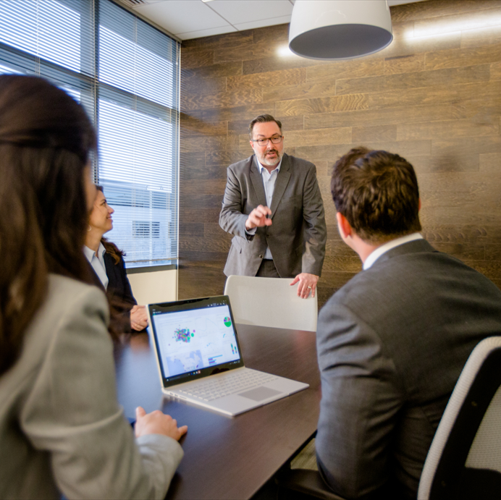
Introductions
Name
Company
Role
What are you hoping to get from this workshop?

Slide 6
Case Study
Trey Research
Notes:
Creating this as “Patterns” and “Tools” – because we want to show them different options for creating their white boarding session.
Ideally, we want to teach them “Here is a typical pattern to implement. At each phase, you have a choice of several different tools – each with pros and cons.
The overall pattern for the following slides is:
“Here’s a basic architecture”
“Here’s a brief synopsis of the new tools”
“Here’s a slightly different architecture”
“Here’s a brief synopsis of the new tools”
Repeat

Slide 7
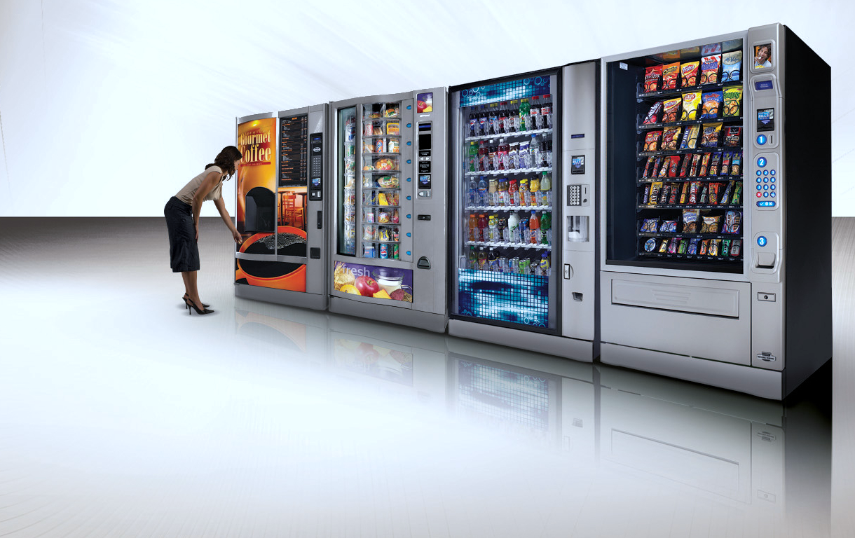
Trey Research
Delivers innovative retail experiences that delight customers and drive sales

Slide 8
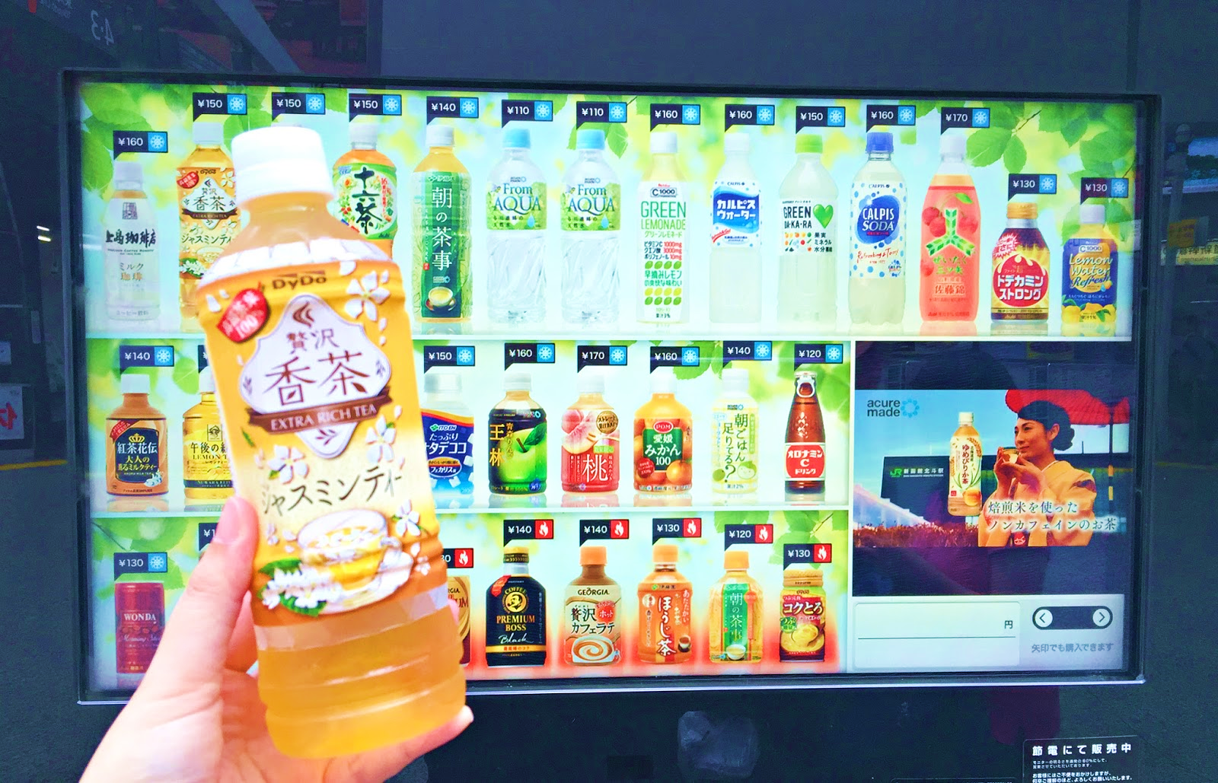
Introducing Vending Machine IO
HD Video Support
Touch-Enabled Display
Built-In Camera
Cash, Credit & NFC
WiFi or 4G LTE

Slide 9



Vending Machine IO: Intelligence
Dwell Time
Duration of interaction
Impressions
Ads & promos displayed
Conversions
Items purchased

Slide 10
Vending Machine IO : New Interactions
Select ads based on machine inventory
Recommend products based on consumer
Present just-for-you pricing to achieve outcomes

Slide 11
Trey Research’s Needs
IoT solution handling high-volumes of data and capable of communicating ad updates to vending machine
Data store to house TBs of data while supporting interactive SQL queries
Ability to prepare data & train models, ideally using R
Ability to quickly identify customer demographics from transmitted camera images

Slide 12
Azure Technologies
Building Blocks
Notes:
Creating this as “Patterns” and “Tools” – because we want to show them different options for creating their white boarding session.
Ideally, we want to teach them “Here is a typical pattern to implement. At each phase, you have a choice of several different tools – each with pros and cons.
The overall pattern for the following slides is:
“Here’s a basic architecture”
“Here’s a brief synopsis of the new tools”
“Here’s a slightly different architecture”
“Here’s a brief synopsis of the new tools”
Repeat

Slide 13

Functional Layers
INGEST
TRANSFORM
ANALYZE
PUBLISH
Source Data
ORCHESTRATION
Apps + Insights

Slide 14
INGEST Land the data for downstream processing
Storage Blobs
Simple, Cheap
Batch
Data Lake Store
High-Performance, POSIX Security
Event Hub
Simple, Cheap
Stream
IoT Hub
Device Registration, Bi-Directional
HDInsight Kafka
Very High Scale, Large Message Size

Slide 15

TRANSFORM Enhance & cleanse the data for analysis
SQL Database
Familiar, Relational
HDInsight Hive & Pig
Massive Scale, Batch
Storage Blobs
Simple, Cheap
Batch
SQL Data Warehouse
Massive Scale, Relational
HDInsight Spark
Massive Scale, High Performance
Data Lake Store
High-Performance, POSIX Security
Data Lake Analytics
Massive Scale, Clusterless
Batch
Massive Scale, Task-Parallel
Event Hub
Simple, Cheap
Stream Analytics
Simple, Easy Integration
Stream
IoT Hub
Device Registration, Bi-Directional
HDInsight Spark
Massive Scale, Mainstream Adoption
HDInsight Kafka
Very High Scale, Large Message Size
HDInsight Storm
Massive Scale, Very Low Latency

Slide 16











ANALYZE Build predictive models from historical data
HDInsight Spark
Large scale advanced analytics
Cognitive Services
Pre-Built, Easy to Integrate
Machine Learning Workbench
State-of-the-art data prep, modeling and deployment
Translation
Text Analytics
Machine Learning Server
The Platform for your R and Python coding
Speech
Recommendation
Data Science Virtual Machine
Pre-configured “data science in a box” environment
Language Understanding
Emotion
Computer Vision

Slide 17




PUBLISH Interactive data presentation
HDInsight Spark
Massive Scale, Pseudo-Relational
CosmosDB
Massive Scale, Geo-Distributed, Multi-Faceted NoSQL
HDInsight HBase
Massive Scale, Column-Family
Search
Elastic Search, Ease of Integration
SQL Database
Familiar, Relational
Analysis Services
In-Memory, Semantics
SQL Data Warehouse
Massive Scale, Relational
Power BI
Desktop & Dashboards

Slide 18
Orchestrate Coordinate activities across layers
Data Factory
Graphical UI, Robust Management
Automation
Simple, Massive Library
Functions
Event-Triggered, Serverless

Slide 19
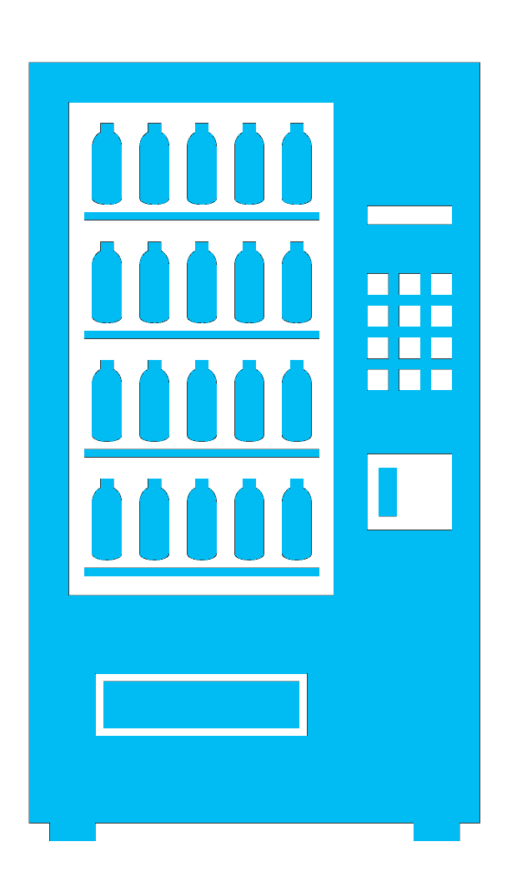
Solution Whiteboarding
Review, Design & Present

Slide 20
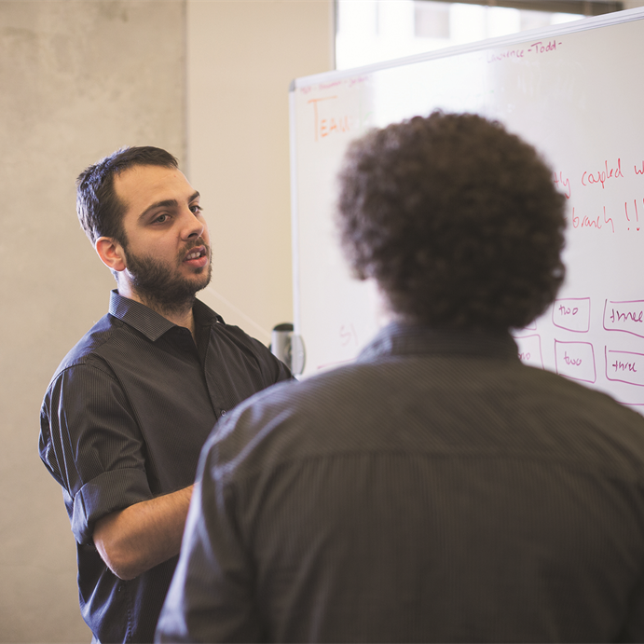
Design the Solution
Design a solution and prepare to present the solution to the target customer audience in a 15-minute chalk-talk format.
Business Needs (10 minutes) | Discuss the business scenario Use the learner guide to clarify the business case
Design (35 minutes) | Design a solution for as many of the stated requirements as time allows. Show the solution on a flipchart.
Prepare (15 minutes) | Identify any customer needs that are not addressed with the proposed solution. Identify the benefits of your solution. Determine how you will respond to the customer’s objections. Prepare for a 15-minute presentation to the customer.

Slide 21

Present the Solution
Present a solution to the target customer audience in a 15-minute chalk-talk format.
Pair with another table.
One table is the Trey Research team and the other table is the consultant team building the solution.
The consultant team presents their proposed solution to the customer.
Trey Research asks one of the objections from the list of objections in the case-study.
The consultant team responds to the objection.
The Trey Research team gives feedback to the consultant team.

Slide 22
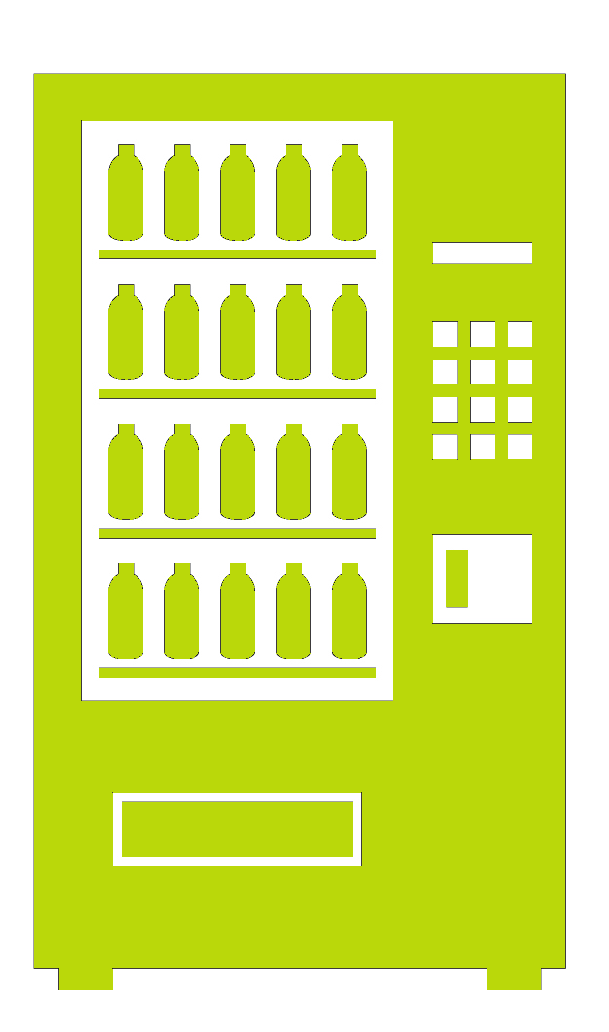
Intelligent Vending Machine Preferred Solution

Slide 23
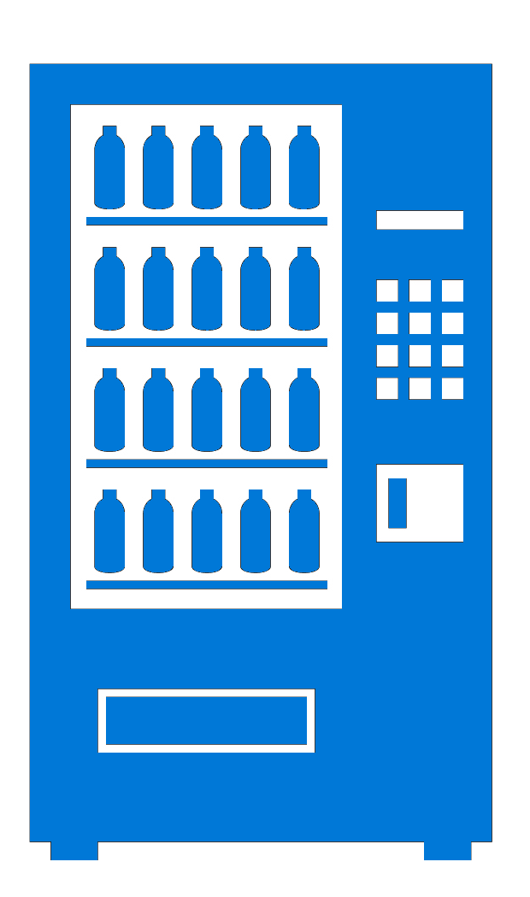

Preferred Solution
telemetry
IoT Hub
Stream Analytics
Passthrough
transactions
Power BI
Desktop & Dashboards
SQL DB Premium
InMemory OLTP
Storage Blobs
Archival
images
Data Science VM
Modeling
publish
Cognitive Services
Facial Recognition API
Facial Sentiment API
image info
R-Service VM
REST API

Slide 24
Intelligent Vending Machine
Hands-On-Lab
Notes:
Creating this as “Patterns” and “Tools” – because we want to show them different options for creating their white boarding session.
Ideally, we want to teach them “Here is a typical pattern to implement. At each phase, you have a choice of several different tools – each with pros and cons.
The overall pattern for the following slides is:
“Here’s a basic architecture”
“Here’s a brief synopsis of the new tools”
“Here’s a slightly different architecture”
“Here’s a brief synopsis of the new tools”
Repeat

Slide 25
Preferred Solution
telemetry
IoT Hub
Stream Analytics
Passthrough
transactions
Power BI
Desktop & Dashboards
SQL DB Premium
InMemory OLTP
Storage Blobs
Archival
images
Data Science VM
Modeling
publish
Cognitive Services
Facial Recognition API
Facial Sentiment API
image info
R-Service VM
REST API

Slide 26
Hands-On Lab
Build a Machine Learning Model
Setup Azure Data Factory
Develop Data Factory Pipeline
Operationalize ML Scoring
Summarize Data with Spark
Visualize Data in Power BI
Deploy Intelligent Web App
Cleanup Azure Resources

